Slide 1











Flighty Project

Slide 2


Team Members
01
Shimaa Ayman Mohamed
02
Shimaa Adel Awieda
03
Aisha Ramadan GadElrab
04
Shaza Atef Sobhy
Supervised by :
Eng/Abdallah Mohamed

Slide 3

Content
01
02
03
Introduction
objectives
pages details & gui
04
05
06
database & erd
future features
conclusion

Slide 4






01
introduction
previous system - current system - purpose - scope

Slide 5




1.1 Previous System
In the previous system, flight management and booking processes were handled using traditional and manual methods or through limited systems with minimal automation. Users often relied on travel agencies or offline procedures to search for flights and complete bookings. These methods were time-consuming, error-prone, and lacked real-time updates. Additionally, administrative tasks such as managing flights and airports required manual record keeping, which increased the risk of data inconsistency and inefficiency

Slide 6
1.2 Current System
The current system is a web-based Flight Management System that automates the process of managing flights and booking reservations. It provides an interactive user interface that allows users to search for available flights, register, log in, and book flights online. Administrators can efficiently manage flights and airports through a centralized system. The system improves accuracy, reduces manual effort, and provides real-time access to flight data for both users and administrators.

Slide 7




1.3 Purpose
The purpose of the Flight Management System is to provide a reliable and efficient platform for managing flight operations and reservations. The system aims to simplify the booking process for users and enable administrators to manage flight and airport data effectively. It enhances user experience by offering fast access to flight information while ensuring data accuracy and system security.

Slide 8
1.4 Scope
The scope of the Flight Management System includes:
User registration and authentication
Flight search and booking functionality
Viewing and managing booked flights
User and admin account management
Admin control over flight and airport management
Secure handling of user and flight data
The system does not include online payment processing or flight cancellation features in its current version but can be extended in future releases.

Slide 9
02
objectives
Problem Definitions - Goals

Slide 10




2.1 Problem Definition
Managing flight information and reservations using manual or partially automated systems leads to several challenges. Users face difficulties in searching for suitable flights, completing bookings efficiently, and accessing their booking history. On the administrative side, managing flights and airports manually increases the risk of data redundancy, inconsistency, and human errors. Additionally, the lack of a centralized system makes it difficult to maintain accurate and up-to-date flight information.

Slide 11

2.2 Goals
The main goals of the Flight Management System are:
To provide a centralized platform for managing flight and airport information.
To enable users to search and book flights easily through an online system.
To reduce manual work and minimize human errors in flight management processes.
To improve data accuracy and consistency by using a structured database system.
To allow administrators to efficiently add, update, and delete flight and airport data.
To enhance user experience through a simple and intuitive user interface.
To ensure secure access to the system through authentication and authorization mechanisms.
To enable user to show his booked flight, update and delete them.

Slide 12
03
page Details & gui
Main page - Login - Sign up
User : Main page (after login) - Book - Booked - Account User
Admin : Main page (after login) - Manage Flight - Manage Airport Account Admin

Slide 13





Description
This page represents the landing page of the Flight Management System. It allows guests to view available flights without requiring authentication.
Functionalities
Display a list of available flights
Search flights by:
Source airport
Destination airport
Date
Redirect users to login or signup before booking
Access Level
Guest / User
3.1 Main Page

Slide 14

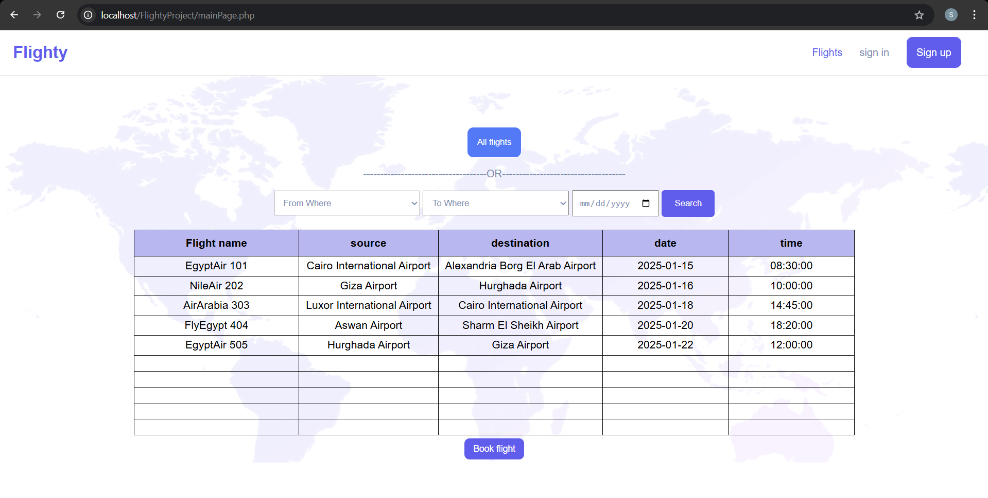



Slide 15
3.2 Login Page
Description
This page allows registered users and administrators to access the system using their credentials.
Functionalities
Enter email or phone number
Enter password
Validate login credentials
Redirect user based on role (User / Admin)
Access Level
Guest

Slide 16
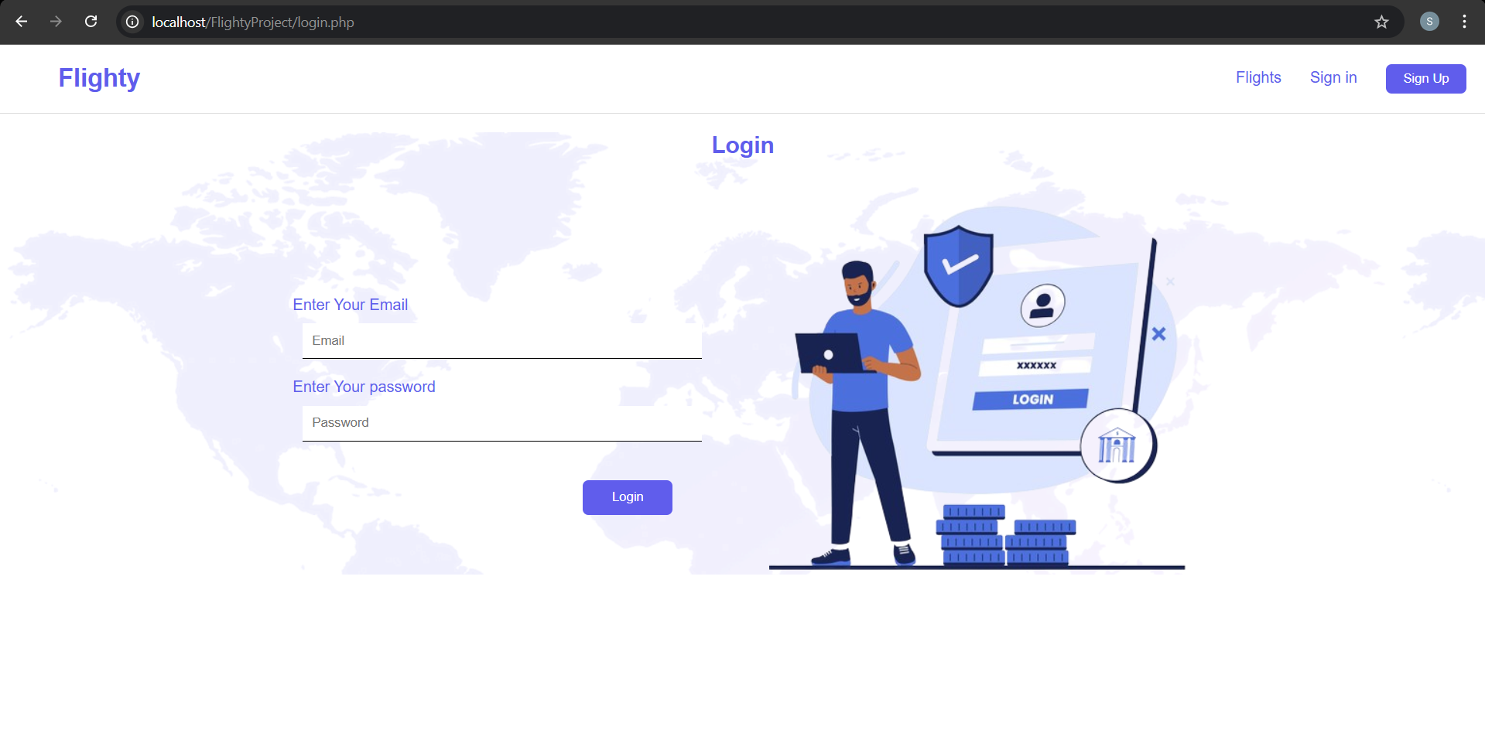

Slide 17
Description
This page allows new users to create an account in the system.
Functionalities
Enter personal information:
First name and last name
Email
Phone number
Address
Age
Gender
Password and confirmation
Validate input data
Create a new user account
Access Level
Guest
3.3 SignUp Page

Slide 18
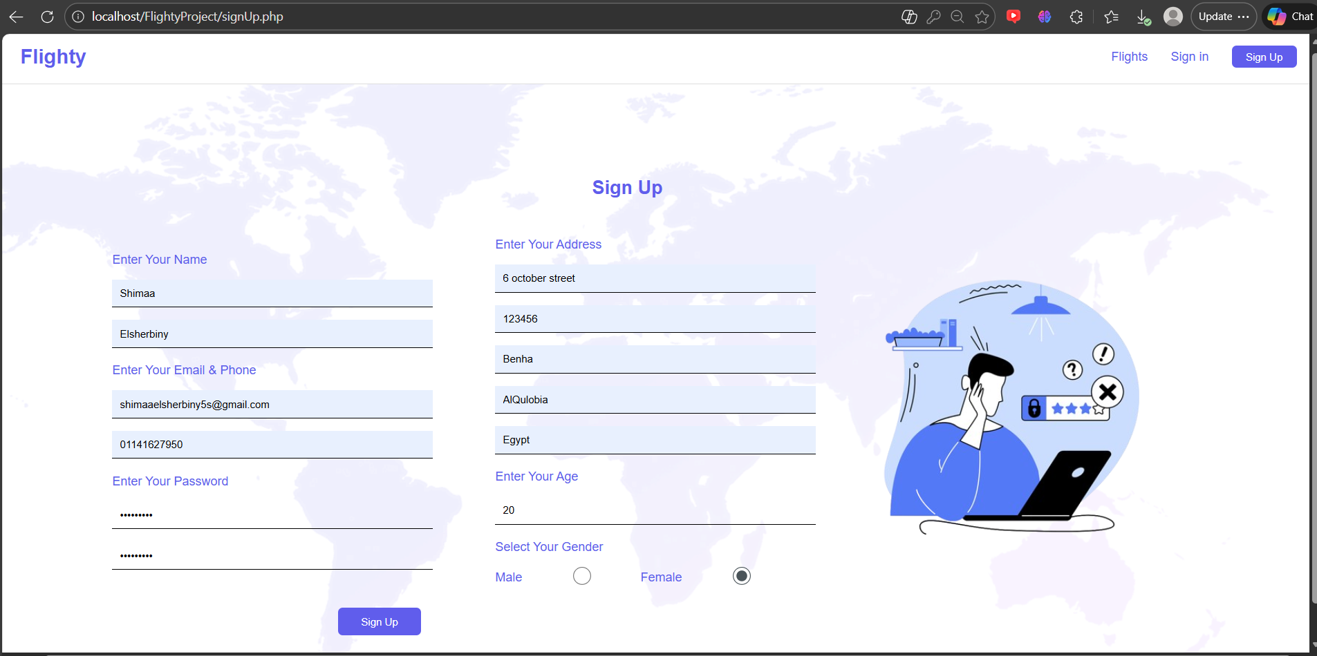

Slide 19
Description
This page is displayed after a user logs in successfully. It shows available flights and user-specific navigation options.
Functionalities
View available flights
Search flights by:
Source airport
Destination airport
Date
Book flight
Navigate to:
Booked flights
User account
Access Level
User
3.4 User Main Page

Slide 20
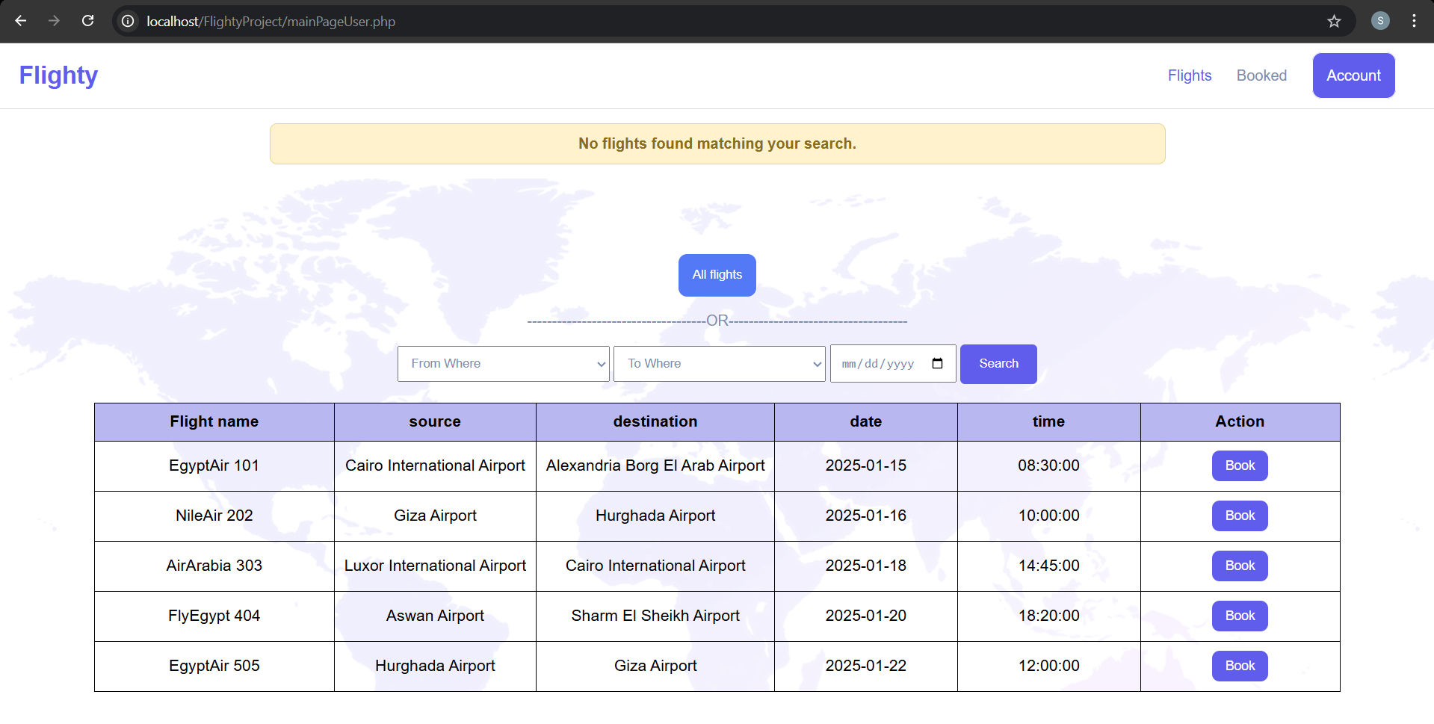

Slide 21
Description
This page allows users to book a selected flight by entering booking details.
Functionalities
Display selected flight information
Enter booking details:
Business seats
Economy seats
Number of bags
Calculate total price
Confirm booking
Navigate to:
Booked flights
User account
Flights
Access Level
User
3.5 Book Flight Page

Slide 22
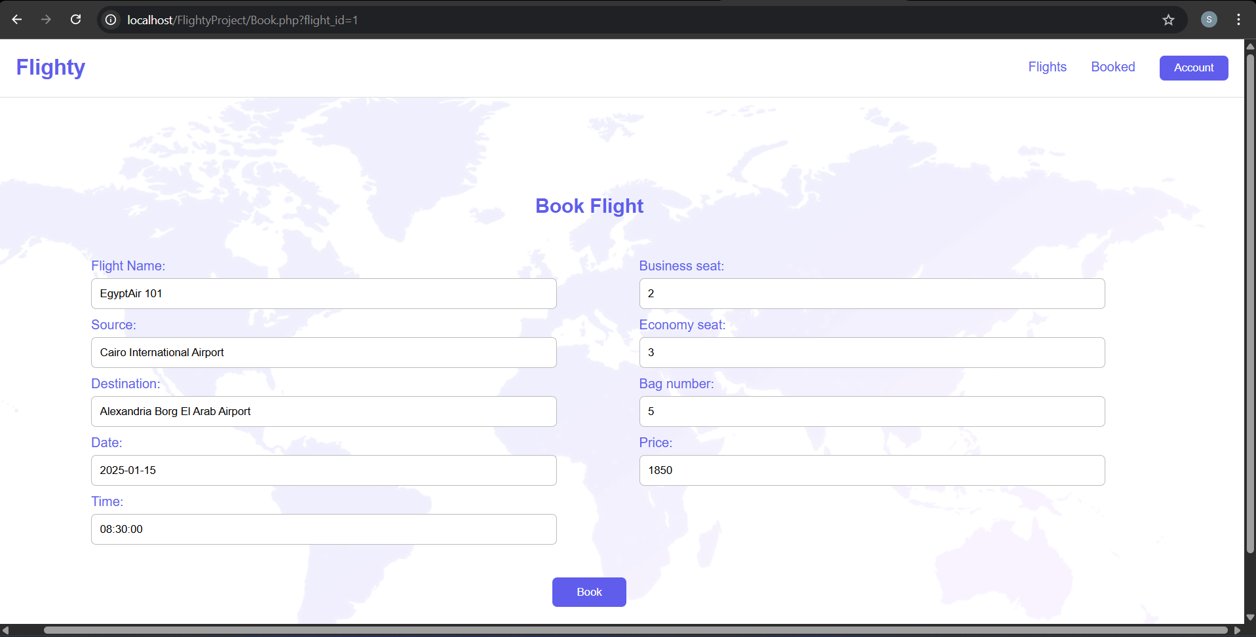

Slide 23
Description
This page displays all flights booked by
the logged-in user.
Functionalities
View booking details
Update & Delete a booking
Display booking history in tabular format
Navigate to :
User account
Flights
Access Level
User
3.6 Booked Flight Page

Slide 24
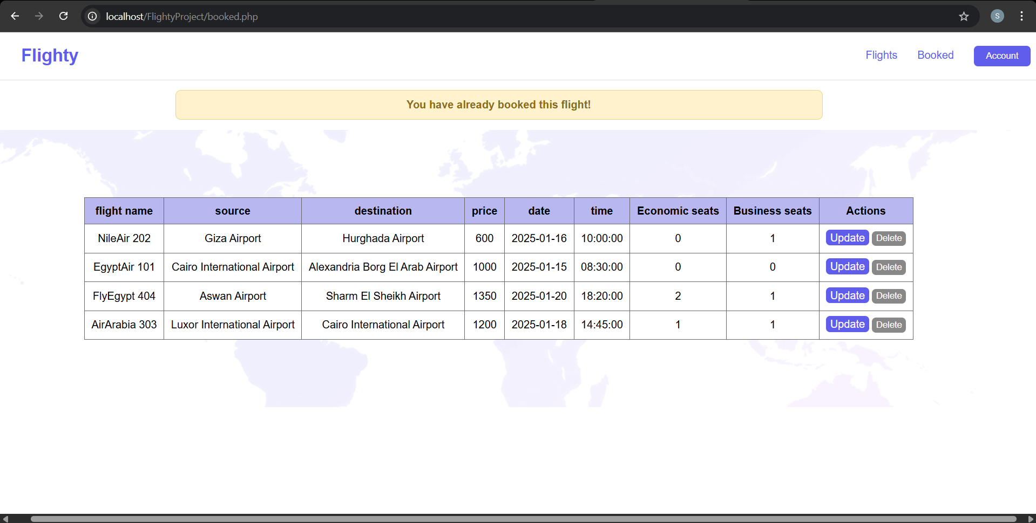

Slide 25
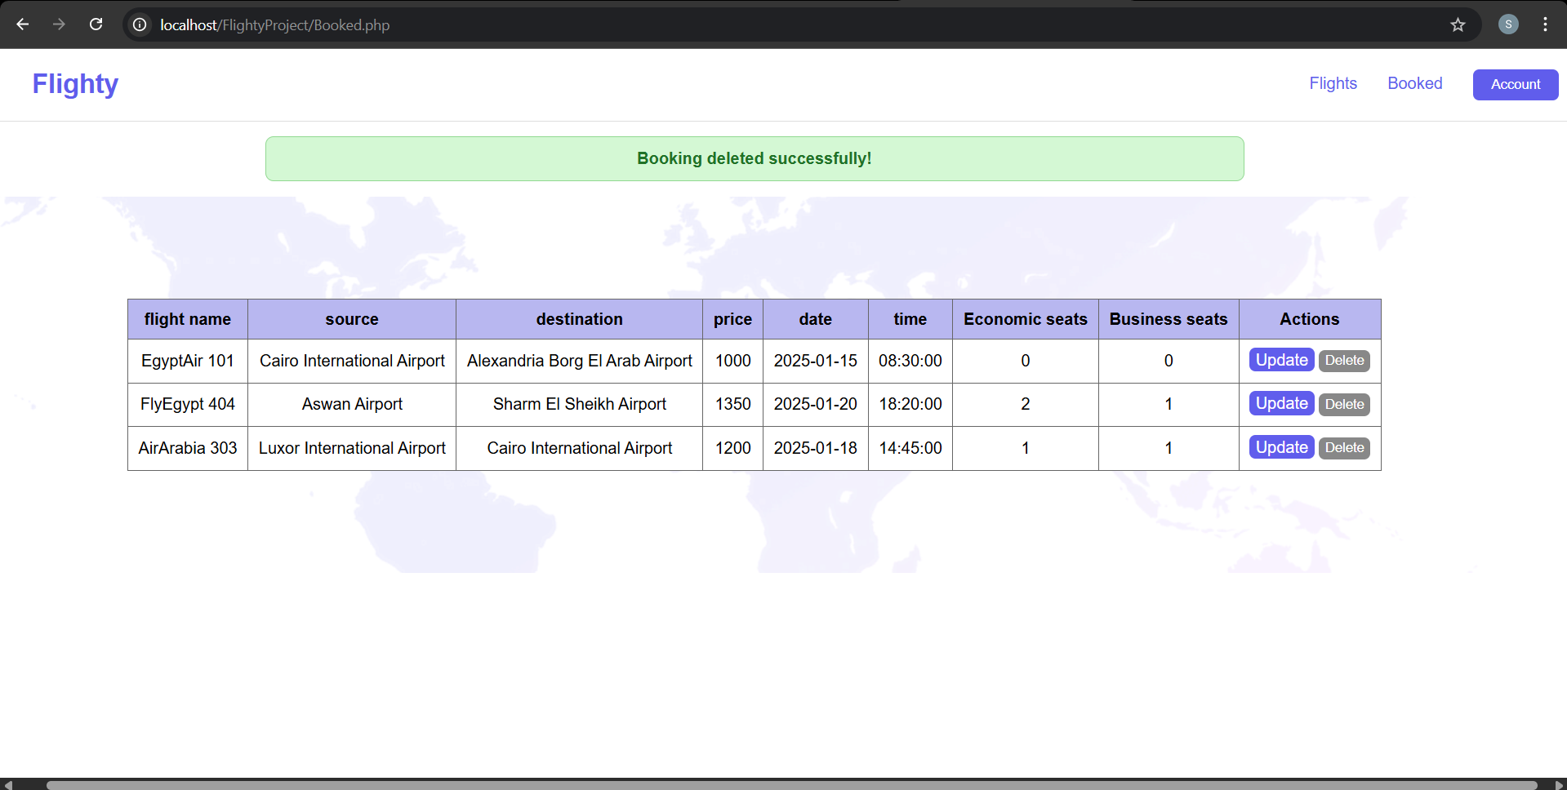

Slide 26
3.8 User Account Page
Description
This page allows users to view and
update their personal account information.
Functionalities
View user profile data
Update personal information
Change password
Navigate to :
Booked flights
Flights
Access Level
User

Slide 27
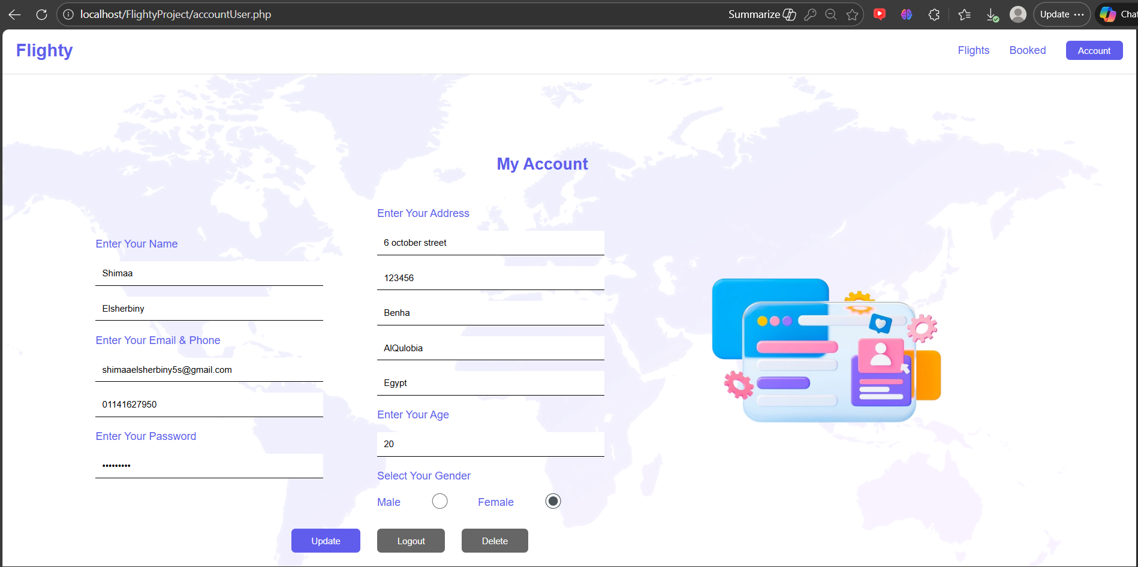

Slide 28
3.9 Admin Main Page
Description
This page is the main dashboard for administrators after login.
Functionalities
View all flights
Navigate to:
Manage flights
Manage airports
Admin account
Access Level
Admin

Slide 29
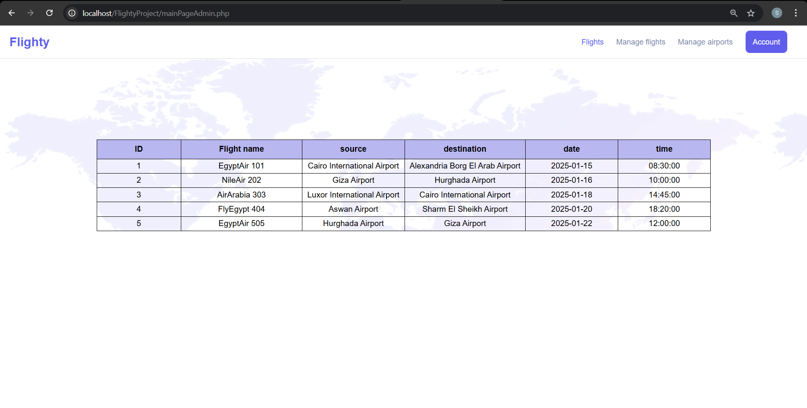

Slide 30
Description
This page allows administrators to
manage flight information.
Functionalities
Add new flight
Delete flight
Update flight details
Search by id
Display all flights in a table
Navigate to :
Manage airport
Admin account
Flights
Access Level
Admin
3.10 Manage Flight Page

Slide 31
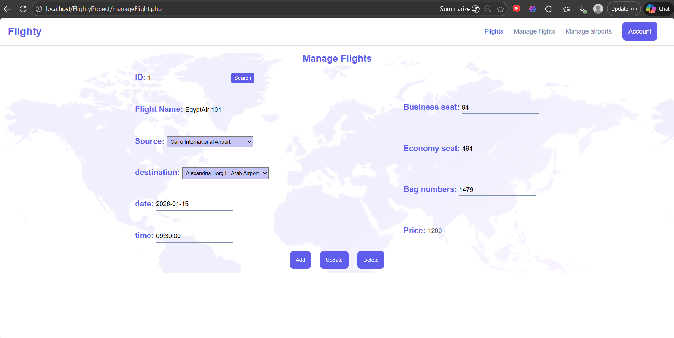

Slide 32
Description
This page allows administrators to
manage airport information.
Functionalities
Update airport details
Delete airport
Display airports list
Navigate to :
Manage flights
Admin account
Flights
Access Level
Admin
3.11 Manage Airport Page

Slide 33
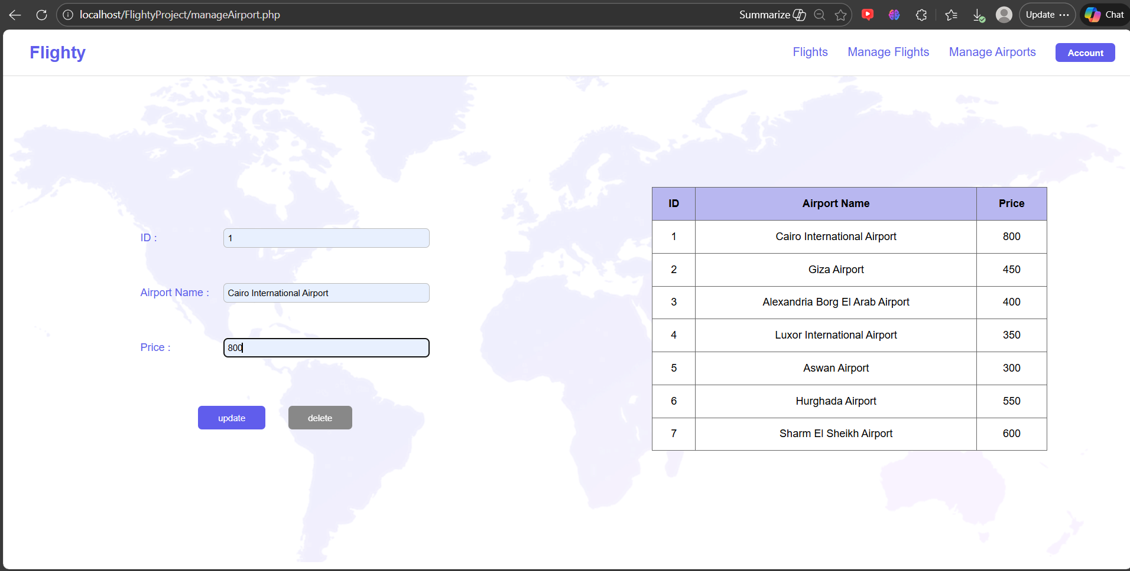

Slide 34
Description
This page allows administrators to view
and update their account information.
Functionalities
View admin profile
Update personal data
Change password
Navigate to :
Manage flights
Manage airports
Flights
Access Level
Admin
3.12 Admin Account Page

Slide 35


Slide 36
04
database & erd
Users Table - Flights Table - UserFlights Table - Airport Table - FlightAirport Table
ARD

Slide 37



4.1 Users Table
Stores user account information.
id (INT): Unique user identifier (Primary Key).
role (VARCHAR(50)): User role in the system (User- Admin).
email (VARCHAR(100)): User email address (unique).
password (VARCHAR(255)): User password.
first_name (VARCHAR(50)): User first name.
last_name (VARCHAR(50)): User last name.
phone (VARCHAR(20)): User phone number.
address (VARCHAR(255)): User address.
zip (VARCHAR(10)): Postal code.
city (VARCHAR(50)): City name.
state (VARCHAR(50)): State or governorate.
country (VARCHAR(50)): Country name.
gender (VARCHAR(10)): User gender.
age (INT): User age.

Slide 38
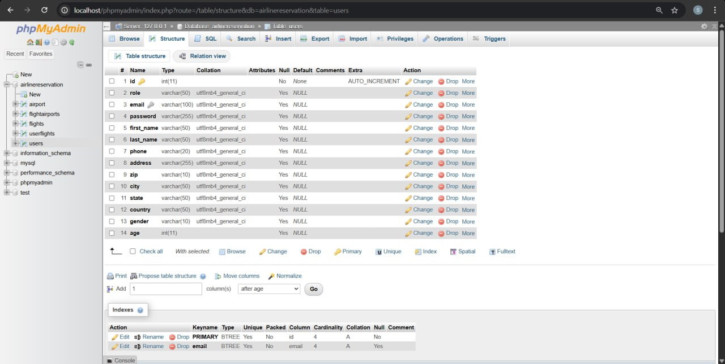

Slide 39
4.2 Fights Table
Stores flight details.
id (INT): Unique flight identifier (Primary Key).
flight_name (VARCHAR(100)): Flight name or code.
source (VARCHAR(100)): Source Airport Name.
destination (VARCHAR(100)): Destination Airport Name.
date (DATE): Flight date.
time (TIME): Flight time.
business_seat (INT): Available business class seats.
economy_seat (INT): Available economy class seats.
bag_number (INT): Allowed number of bags.

Slide 40
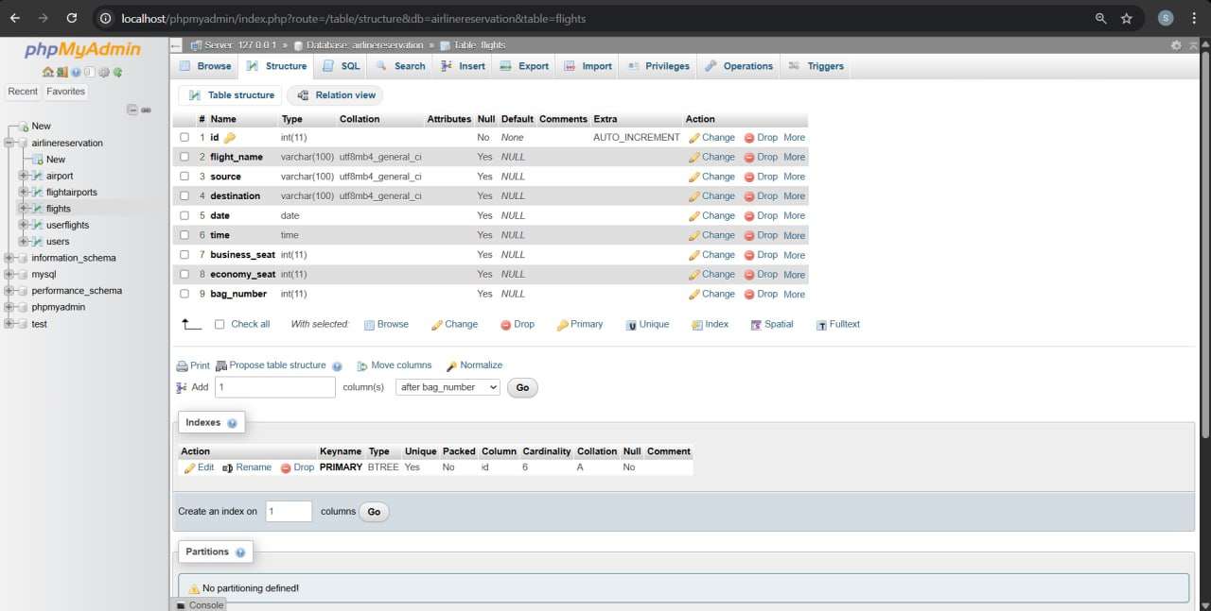

Slide 41
4.3 Airport Table
Stores airport information.
id (INT): Unique airport identifier (Primary Key).
airport_name (VARCHAR(100)): Airport name.
price (INT): Airport-related cost

Slide 42
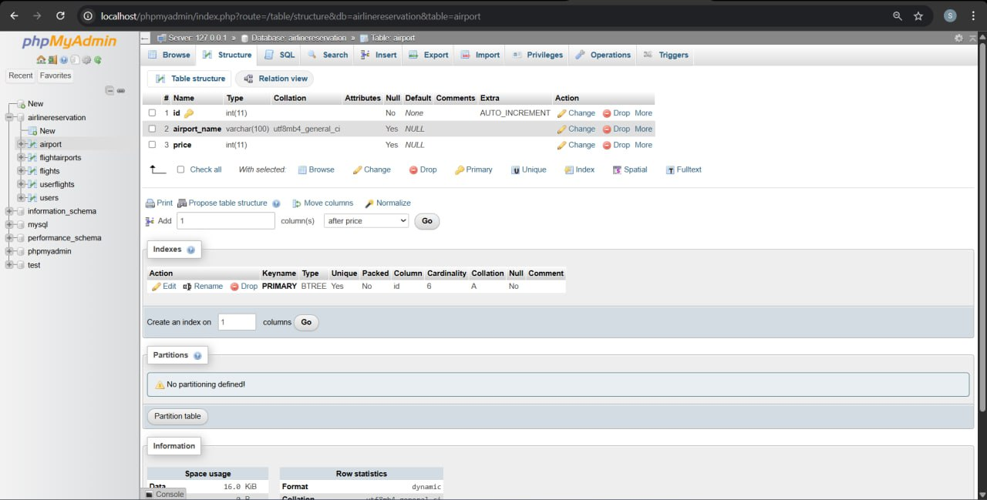

Slide 43
4.4 UserFights Table
Stores flight booking details.
id (INT): Unique booking identifier (Primary Key).
user_id (INT): User reference (Foreign Key).
flight_id (INT): Flight reference (Foreign Key).
business_seat (INT): Booked business seats.
economy_seat (INT): Booked economy seats.
bag_number (INT): Number of booked bags.
price (INT): Total booking price.

Slide 44
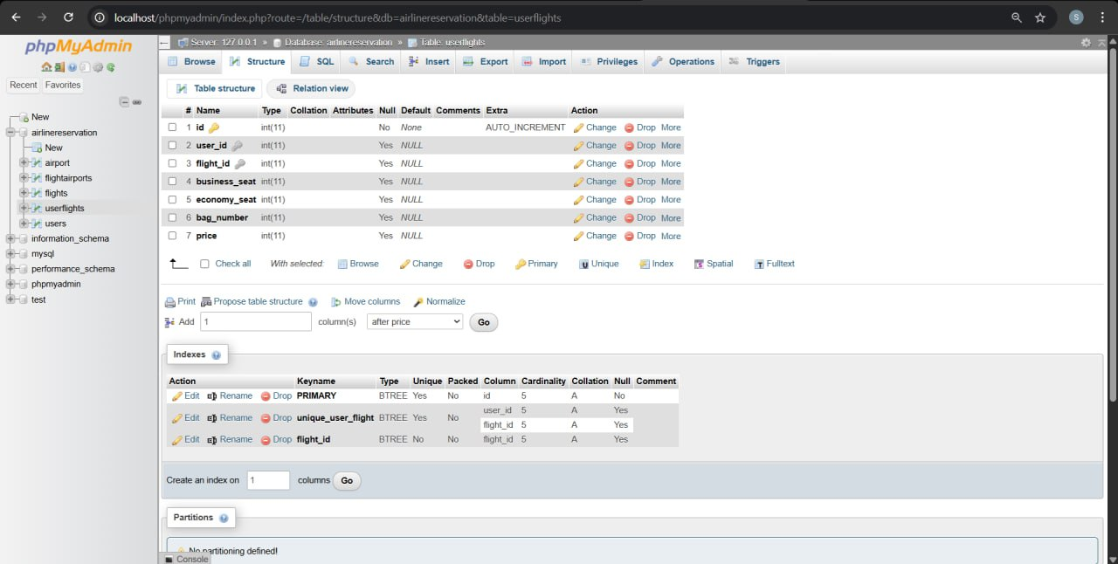

Slide 45
4.5 FightAirports Table
Links flights with airports.
flight_id (INT): Flight reference (Foreign Key).
airport_id (INT): Airport reference (Foreign Key).

Slide 46
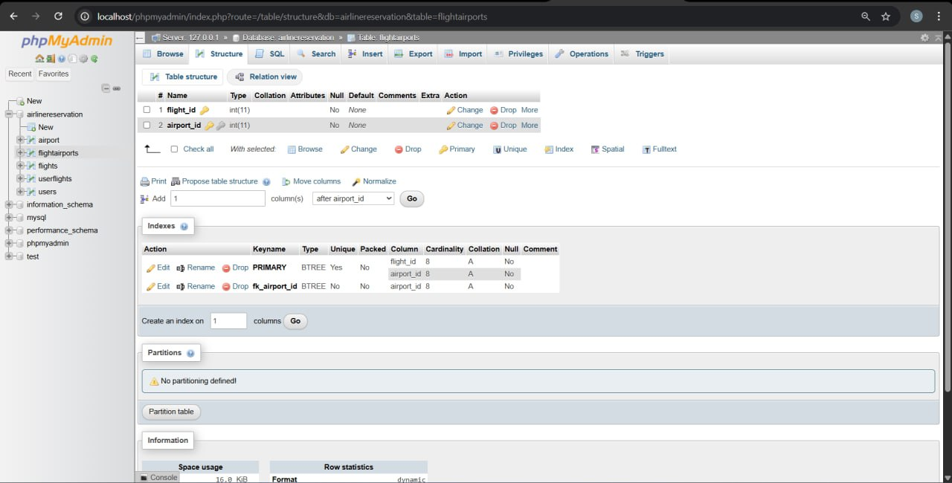

Slide 47
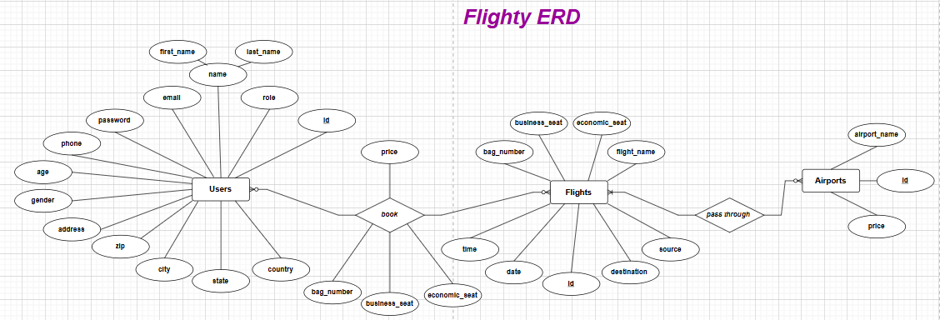
4.6 ERD

Slide 48
05
Future features

Slide 49





5.2 Flight Cancellation and Refund
Enable users to cancel booked flights and request refunds according to airline policies.
5.1 Online Payment System
5.3 Email and SMS Notifications
Integrate secure online payment methods such as credit cards and digital wallets to allow users to complete flight bookings with real-time payment processing.
Send automatic notifications to users for:
Booking confirmation
Flight updates or delays
Cancellation alerts

Slide 50
5.5 Admin Reports and Analytics
Allow administrators to generate reports such as:
Booking statistics
Popular routes
Revenue analysis
5.4 Real-Time Flight Status
5.6 Multi-Language Support
Provide real-time updates on flight status, including delays, boarding time, and gate information.
Support multiple languages to improve accessibility for international users.

Slide 51
5.8 Mobile Application Support
Develop a mobile application version of the system for Android and iOS platforms.
5.7 Role-Based Access Control Enhancement
5.9 Loyalty and Discount System
Introduce more detailed roles and permissions, such as:
Super Admin
Customer Support Staff
Introduce loyalty programs, promo codes, and discounts for frequent travelers.

Slide 52
06
Conclusion

Slide 53



The Flight Management System provides an efficient and user-friendly solution for managing flight reservations and related operations. The system successfully automates the process of flight searching, booking, and administration, reducing manual effort and minimizing errors. By offering separate functionalities for users and administrators, the system ensures organized data management and secure access to system resources.
The implemented system improves accessibility to flight information and enhances the overall user experience through a simple and intuitive interface. In addition, the use of a structured database design ensures data accuracy, consistency, and scalability. Although the current version focuses on core functionalities, the system is designed to support future enhancements such as online payments, real-time notifications, and advanced reporting features.
Overall, the Flight Management System achieves its objectives and provides a strong foundation for future development and expansion.

Slide 54






THANKS!
DO YOU HAVE ANY QUESTIONS?

